Slide 1

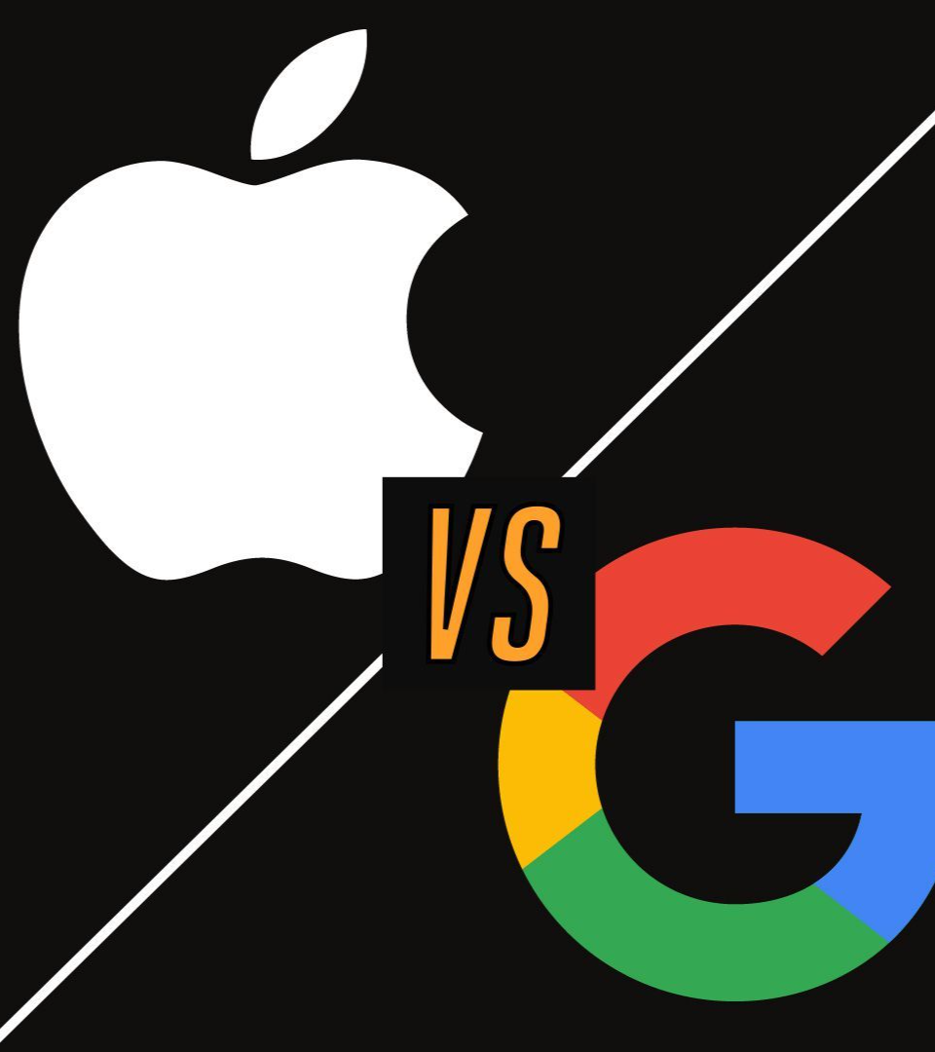
Sentiment Classification of Tweets about Apple and Google Products using NLP
Members;
Brenda Kinoti, John Karanja, Victor Mawira, Michelle Mwendwa, Loise Mbago, Stephen Gathai.

Slide 2

Identifying Key Drivers of Customer Satisfaction
In today's competitive market, businesses need to constantly monitor their customers' satisfaction to stay ahead. Our project aims to use machine learning to identify the key drivers of customer satisfaction, using online reviews and ratings. This information can help businesses make data-driven decisions to improve their products and services.

Slide 3
Project Objectives
1
Sentiment Analysis
2
Natural Language Processing Techniques
3
Prediction System
To classify tweets about Apple and Google products as positive, negative, or neutral.
To create a user-friendly prediction system that allows users to input a tweet, and the system should provide a sentiment rating based on the content of the tweet.
To implement various NLP preprocessing steps, such as tokenization, stopword removal, and text normalization, to prepare the tweet data for effective analysis and modeling.

Slide 4

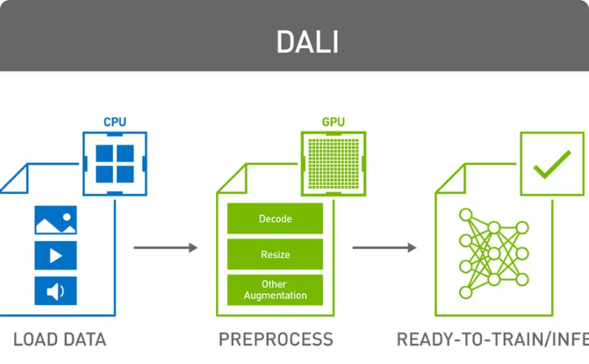
Data collection and preprocessing
Data Collection
Data Preprocessing
The dataset contains 9092 tweets obtained from CrowdFlower Open Source Datasets. The tweets are are about either Apple or Google or any of their respective products and services.
This included tokenization, stemming, lemmatization, removal of stop words from the tweets. Filling of missing values to prepare the tweets for further analysis.

Slide 5
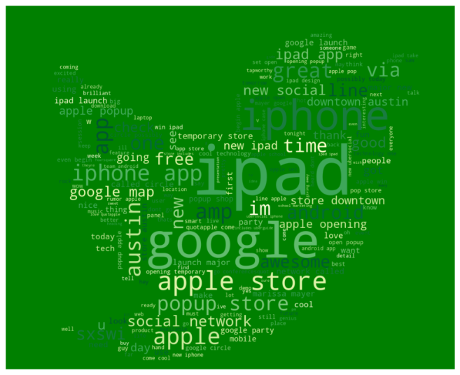
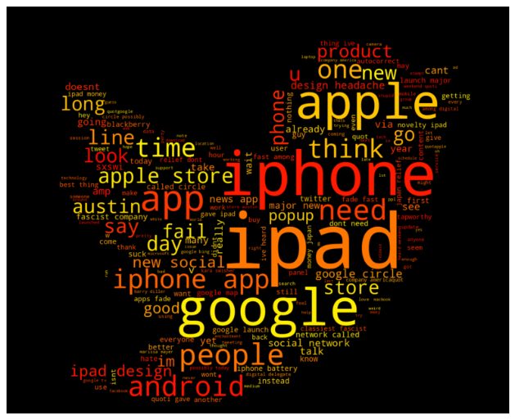
EDA Analysis for Positive, Negative and Neutral Sentiments
Positive Sentiment
Negative Sentiment

Slide 6
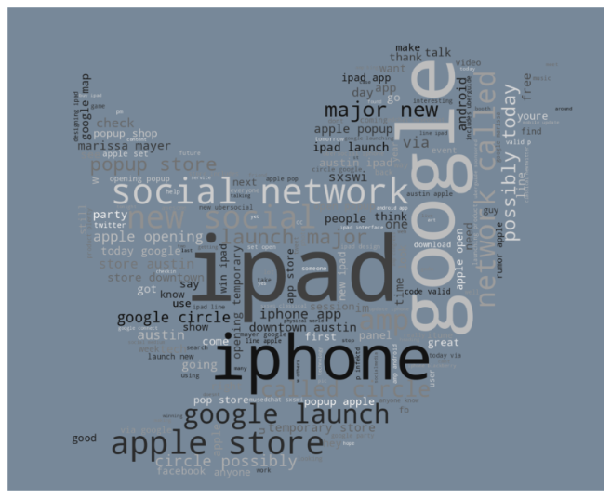
Neutral Sentiments
Comments
We can see that a lot of people are about a new and temporary pop-up store downtown, ipad 2 launch, Google's Marissa Mayer and a new social network called circle.
People were unhappy about the new design for ipad, and also on the iphone battery. The new social circle also has some negative feedback.
Neutral emotions about the social network circle as well as the pop up stores.

Slide 7
Modelling results and evaluation
Model | Accuracy | Precision (weighted avg) | Recall (weighted avg) | F1-Score (weighted avg)
Logistic Regression | 0.65 | 0.62 | 0.65 | 0.62
Naive Bayes | 0.65 | 0.62 | 0.65 | 0.61
XG Boost | 0.66 | 0.65 | 0.66 | 0.63
Random Forest | 0.67 | 0.66 | 0.67 | 0.65
Modelling process:
Train/test Split
TF-IDF Vectorizer
Building the classifiers
Evaluation
Highest performing model was Random Forest with an overall 67% accuracy in classifying tweet sentiment
The model is better at classifying negative tweets than positive tweets

Slide 8
Recommendations
Brand/Product Awareness
Sentiment Analysis
Frequent Terms
Prioritize marketing and investment strategies around hp products like the iPad, Apple, and iPad/iPhone app slightly mentioned.
Leverage the predominantly neutral and positive sentiment for positive investment and marketing decisions. Address negative sentiment to uphold brand reputation.
Utilize frequently mentioned terms highlighted in the word cloud for targeted marketing and resonating with the audience..
Data-driven Decision Making
Engagement Strategy
Data-driven Decision Making
Utilize the cleaned and transformed dataset for advanced analyses like trend analysis, topic modelling, and sentiment analysis for customer insights.
Develop strategies to engage neutral segments, converting them into positive brand advocates for increased influence.
Establish ongoing feedback mechanisms using real-time user feedback to enhance products and responsiveness to customer needs.

Slide 9

Next Steps/Future work
Develop a program that can automatically grab tweets for analysis
Build a model to evaluate posts/comments on other forms of social media
Incorporate trending data to see how opinions/brands of products change over time
Train and test models that incorporate engagement on social media eg retweets

Slide 10
Thank You!!!

